Slide 1
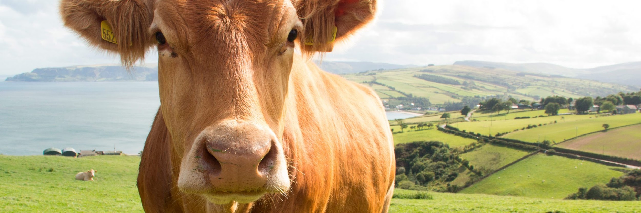

COMPRESSION AND OPTIMIZATION IN THE PRECISION LIVESTOCK FARMING CONTEXT

Slide 2
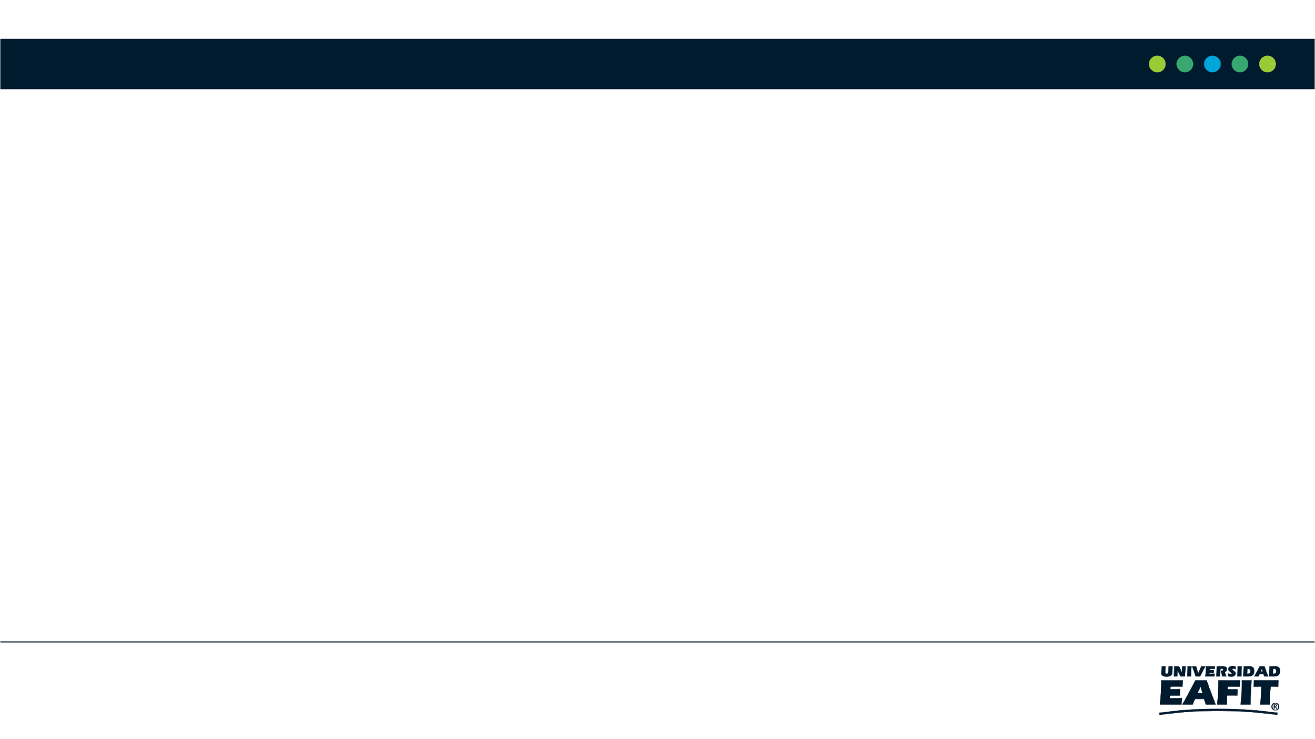
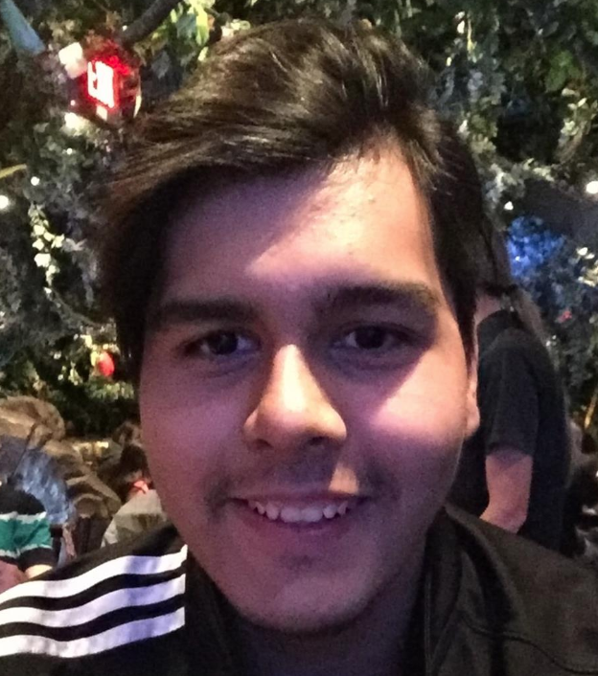



Team Presentation
Julián
Peña
Simón Marín
Mauricio
Toro
https://github.com/AlterBiscuit/ST0245-001

Slide 3
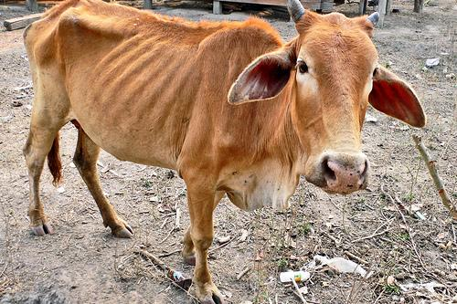
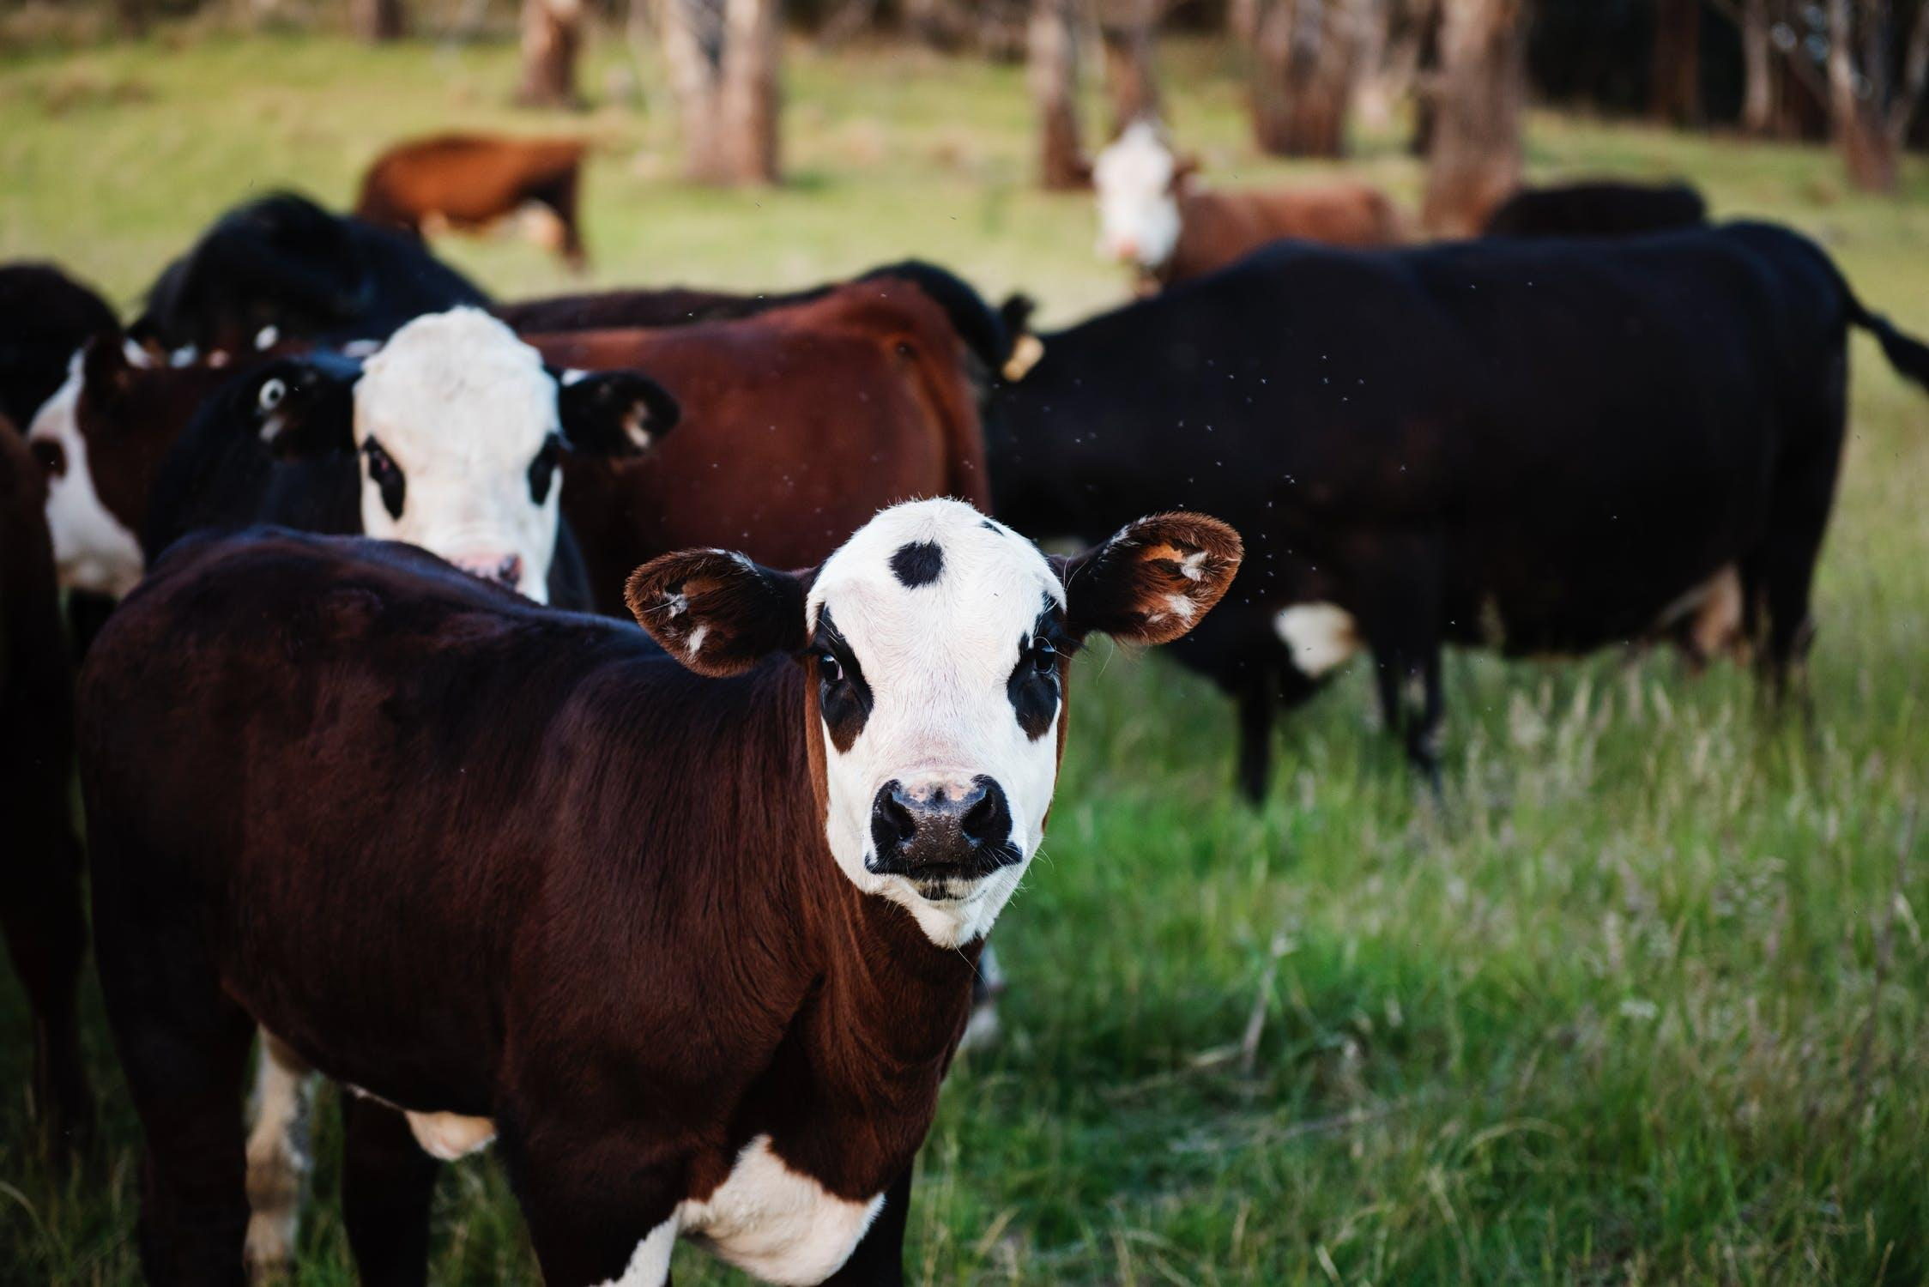
Training Process
Convolutional Neural Network
Sick-Cattle Images
Classification Algorithm
Classification Model
Healthy-Cattle Images

Slide 4
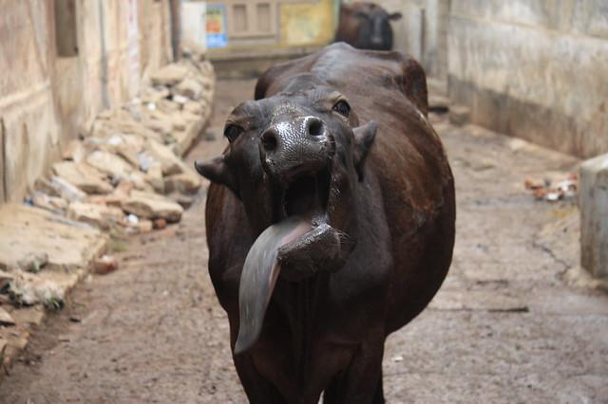
Testing Process
Nearest
Is sick
Cattle Image
Nearest neighbor interpolation
Classification Model
Output

Slide 5
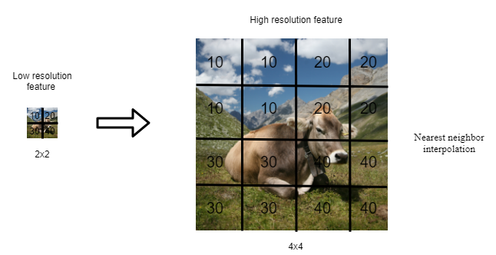
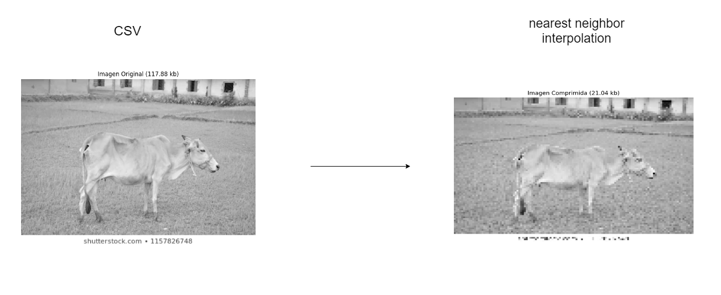
Compression Algorithm Design
nearest neighbor interpolation calculate an average value by some weighting criteria or generate an intermediate value based on complicated rules, this method simply determines the “nearest” neighbouring pixel, and assumes the intensity value of it.

Slide 6
THANK YOU!.
Supported by
The first two authors are supported by a Sapiencia grant financed by Medellín municipality. All the authors would like to thank the "Vicerrectoría de Descubrimiento y Creación", of Universidad EAFIT, for their support on this research

